Slide 1
Chapter 19: Recovery System

Slide 2
Recovery System
19.1 Failure Classification page 721
19.2 Storage page 722
19.3 Recovery and Atomicity page 726
19.4 Recovery Algorithm page 735
19.5 Buffer Management page 738
19.6 Failure with Loss of Nonvolatile Storage
19.7 High Availability Using Remote Backup
19.8 Early Lock Release and Logical Undo Operations
19.9 ARIES
19.10 Remote Backup Systems
19.11 Summary

Slide 3
Transaction
Example of Transaction
Works as a single logical unit
read (A)
A = A – 50
write (A)
Read (B)
B = B + 50
write (B)
Transaction
Operations

Slide 4
COMMIT Operation
Example: Consider the CUSTOMERS table having the following records :
ID | NAME | AGE | ADDRESS
1 | Ko Ko | 32 | Myeik
2 | Ma Ma | 25 | Dewai
3 | Phyu Phyu | 30 | Mandalay
4 | Mi Mi | 27 | Yangon
SQL> DELETE FROM CUSTOMERS WHERE AGE = 25;
SQL> COMMIT;
ID | NAME | AGE | ADDRESS
1 | Ko Ko | 32 | Myeik
3 | Phyu Phyu | 30 | Mandalay
4 | Mi Mi | 27 | Yangon

Slide 5
ROLLBACK Operation
Example: which would delete those records from the table which have the age = 25 and then ROLLBACK the changes in the database.
SQL> DELETE FROM CUSTOMERS WHERE AGE = 25;
SQL> ROLLBACK;
Thus, the delete operation would not impact the table and the SELECT statement would produce the following result.
ID | NAME | AGE | ADDRESS
1 | Ko Ko | 32 | Myeik
2 | Ma Ma | 25 | Dewai
3 | Phyu Phyu | 30 | Mandalay
4 | Mi Mi | 27 | Yangon

Slide 6
ACID Properties of Transaction
Atomicity
All actions happen, or none happen.
Consistency (Correctness)
If Database starts consistent, it ends up consistent.
Isolation
Transactions are isolated from one another
Durability
Once a transaction commits, its updates persist

Slide 7
19.1 Failure Classification
Transaction failure :
Logical errors: transaction cannot complete due to some internal error condition
System errors: the database system must terminate an active transaction due to an error condition (e.g., deadlock)
System crash: a power failure or other hardware or software failure causes the system to crash.
Fail-stop assumption: non-volatile storage contents are assumed to not be corrupted by system crash
Database systems have numerous integrity checks to prevent corruption of disk data
Disk failure: a head crash or similar disk failure destroys all or part of disk storage
Destruction is assumed to be detectable: disk drives use checksums to detect failures

Slide 8
Recovery Algorithms
Suppose transaction T_{i} transfers $50 from account A to account B
Two updates: subtract 50 from A and add 50 to B
Transaction T_{i} requires updates to A and B to be output to the database.
A failure may occur after one of these modifications have been made but before both of them are made.
Modifying the database without ensuring that the transaction will commit may leave the database in an inconsistent state
Not modifying the database may result in lost updates if failure occurs just after transaction commits
Recovery algorithms have two parts
Actions taken during normal transaction processing to ensure enough information exists to recover from failures
Actions taken after a failure to recover the database contents to a state that ensures atomicity, consistency and durability

Slide 9
19.2 Storage
Volatile storage:
Does not survive system crashes
Examples: main memory, cache memory
Nonvolatile storage:
Survives system crashes
Examples: disk, tape, flash memory, non-volatile RAM
But may still fail, losing data
Stable storage:
A mythical form of storage that survives all failures
Approximated by maintaining multiple copies on distinct nonvolatile media
RAID – different levels of redundancy and fault tolerance

Slide 10
Data Access
Physical blocks are those blocks residing on the disk.
Buffer blocks are the blocks residing temporarily in main memory.
Block movements between disk and main memory are initiated through the following two operations:
input (B) transfers the physical block B to main memory.
output (B) transfers the buffer block B to the disk, and replaces the appropriate physical block there.
We assume, for simplicity, that each data item fits in, and is stored inside, a single block.

Slide 11
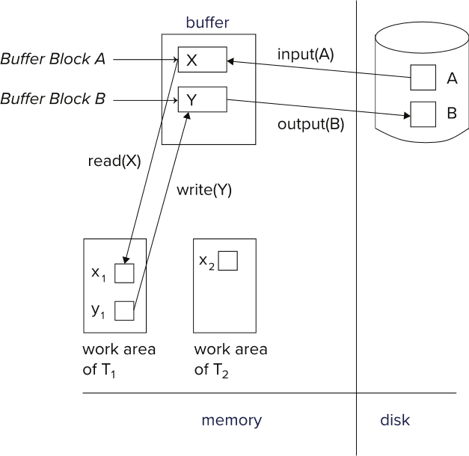
Example of Data Access

Slide 12
Data Access (Cont.)
Each transaction T_{i} has its private work-area in which local copies of all data items accessed and updated by it are kept.
T_{i} 's local copy of a data item X is called x_{i}.
Transferring data items between system buffer blocks and its private work-area done by:
read(X) assigns the value of data item X to the local variable x_{i}.
write(X) assigns the value of local variable x_{i} to data item {X} in the buffer block.
Note: output(B_{X}) need not immediately follow write(X). System can perform the output operation when it deems fit.
Transactions
Must perform read(X) before accessing X for the first time (subsequent reads can be from local copy)
write(X) can be executed at any time before the transaction commits

Slide 13
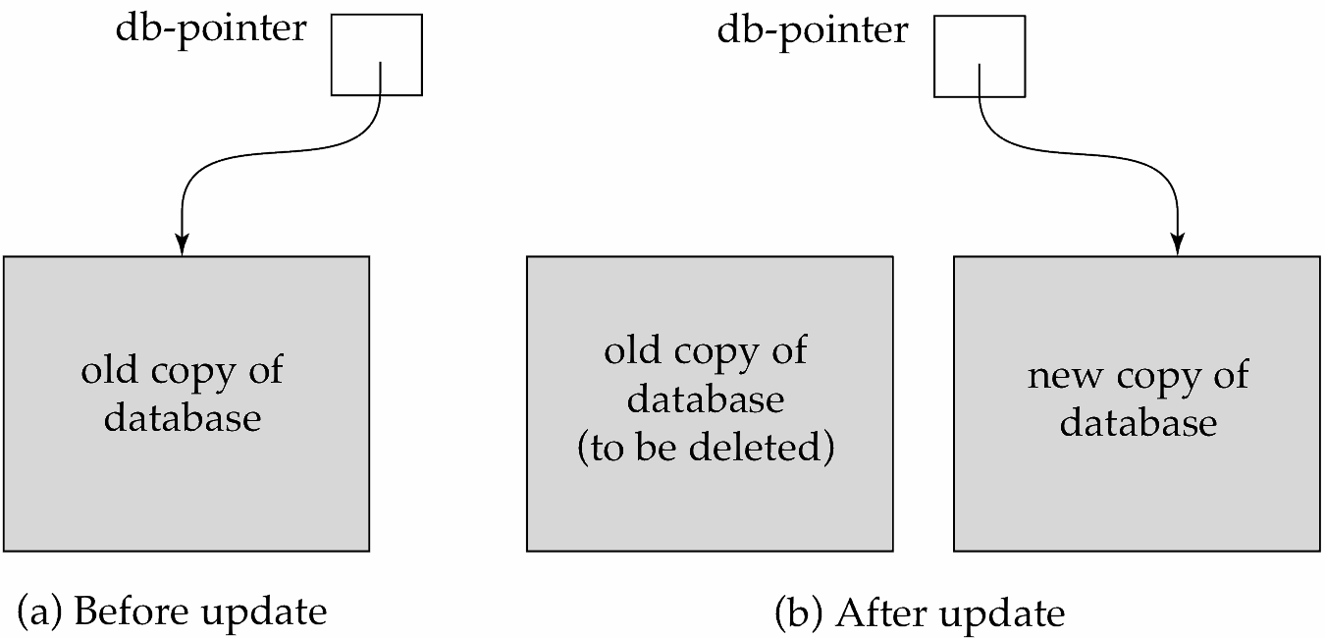
19.3 Recovery and Atomicity
To ensure atomicity despite failures, we first output information describing the modifications to stable storage without modifying the database itself.
We study log-based recovery mechanisms in detail
We first present key concepts
And then present the actual recovery algorithm
Less used alternative: shadow-copy and shadow-paging (brief details in book)
shadow-copy

Slide 14
Log-Based Recovery
A log is a sequence of log records. The records keep information about update activities on the database.
The log is kept on stable storage
When transaction T_{i} starts, it registers itself by writing a
<T_{i} start> log record
Before T_{i} executes write(X), a log record
<T_{i}, X, V₁, V₂>
is written, where V₁ is the value of X before the write (the old
value), and V₂ is the value to be written to X (the new value).
When T_{i} finishes it last statement, the log record <T_{i} commit> is written.
Two approaches using logs
Immediate database modification
Deferred database modification.

Slide 15
Immediate Database Modification
The immediate-modification scheme allows updates of an uncommitted transaction to be made to the buffer, or the disk itself, before the transaction commits
Update log record must be written before database item is written
We assume that the log record is output directly to stable storage
(Will see later that how to postpone log record output to some extent)
Output of updated blocks to disk can take place at any time before or after transaction commit
Order in which blocks are output can be different from the order in which they are written.
The deferred-modification scheme performs updates to buffer/disk only at the time of transaction commit
Simplifies some aspects of recovery
But has overhead of storing local copy

Slide 16
Transaction Commit
A transaction is said to have committed when its commit log record is output to stable storage
All previous log records of the transaction must have been output already
Writes performed by a transaction may still be in the buffer when the transaction commits, and may be output later

Slide 17
Immediate Database Modification Example
Log Write Output
<T₀ start>
<T₀, A, 1000, 950>
<T₀, B, 2000, 2050>
A = 950
B = 2050
<T₀ commit>
<T₁ start>
<T₁, C, 700, 600>
C = 600
B_{B} , B_{C}
<T₁ commit>
B_{A}
Note: B_{X} denotes block containing X.
B_{C} output before T₁ commits
B_{A} output after T₀ commits

Slide 18
Concurrency Control and Recovery
With concurrent transactions, all transactions share a single disk buffer and a single log
A buffer block can have data items updated by one or more transactions
We assume that if a transaction T_{i} has modified an item, no other transaction can modify the same item until T_{i} has committed or aborted
i.e., the updates of uncommitted transactions should not be visible to other transactions
Otherwise, how to perform undo if T₁ updates A, then T₂ updates A and commits, and finally T₁ has to abort?
Can be ensured by obtaining exclusive locks on updated items and holding the locks till end of transaction (strict two-phase locking)
Log records of different transactions may be interspersed in the log.

Slide 19
Undo and Redo Operations
Undo and Redo of Transactions
undo(T_{i}) -- restores the value of all data items updated by T_{i} to their old values, going backwards from the last log record for T_{i}
Each time a data item X is restored to its old value V a special log record <T_{i} , X, V> is written out
When undo of a transaction is complete, a log record <T_{i} abort> is written out.
redo(T_{i}) -- sets the value of all data items updated by T_{i} to the new values, going forward from the first log record for T_{i}
No logging is done in this case

Slide 20
Undo and Redo Operations
Undo of a log record <T_{i}, X, V₁, V₂> writes the old value V₁ to X
Redo of a log record <T_{i}, X, V₁, V₂> writes the new value V₂ to X
Undo and Redo of Transactions
undo(T_{i}) restores the value of all data items updated by T_{i} to their old values, going backwards from the last log record for T_{i}
Each time a data item X is restored to its old value V a special log record <T_{i} , X, V> is written out
When undo of a transaction is complete, a log record <T_{i} abort> is written out.
redo(T_{i}) sets the value of all data items updated by T_{i} to the new values, going forward from the first log record for T_{i}
No logging is done in this case

Slide 21
Recovering from Failure
When recovering after failure:
Transaction T_{i} needs to be undone if the log
Contains the record <T_{i} start>,
But does not contain either the record <T_{i} commit> or <T_{i} abort>.
Transaction T_{i} needs to be redone if the log
Contains the records <T_{i} start>
And contains the record <T_{i} commit> or <T_{i} abort>

Slide 22
Recovering from Failure (Cont.)
Suppose that transaction T_{i} was undone earlier and the <T_{i} abort> record was written to the log, and then a failure occurs,
On recovery from failure transaction T_{i} is redone
Such a redo redoes all the original actions of transaction T_{i} including the steps that restored old values
Known as repeating history
Seems wasteful, but simplifies recovery greatly

Slide 23
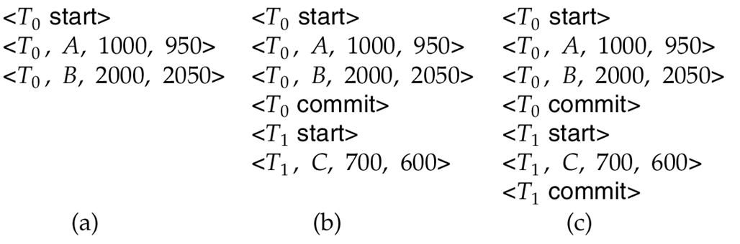
Immediate DB Modification Recovery Example
Below we show the log as it appears at three instances of time.
Recovery actions in each case above are:
(a) undo (T₀): B is restored to 2000 and A to 1000, and log records <T₀, B, 2000>, <T₀, A, 1000>, <T₀, abort> are written out
(b) redo (T₀) and undo (T₁): A and B are set to 950 and 2050 and C is restored to 700. Log records <T₁, C, 700>, <T₁, abort> are written out.
(c) redo (T₀) and redo (T₁): A and B are set to 950 and 2050
respectively. Then C is set to 600

Slide 24
Checkpoints
Redoing/undoing all transactions recorded in the log can be very slow
Processing the entire log is time-consuming if the system has run for a long time
We might unnecessarily redo transactions which have already output their updates to the database.
Streamline recovery procedure by periodically performing checkpointing
1. Output all log records currently residing in main memory onto stable
storage.
2. Output all modified buffer blocks to the disk.
3. Write a log record < checkpoint L> onto stable storage where L is a
list of all transactions active at the time of checkpoint.
4. All updates are stopped while doing checkpointing

Slide 25
Checkpoints (Cont.)
During recovery we need to consider only the most recent transaction T_{i} that started before the checkpoint, and transactions that started after T_{i}.
Scan backwards from end of log to find the most recent <checkpoint L> record
Only transactions that are in L or started after the checkpoint need to be redone or undone
Transactions that committed or aborted before the checkpoint already have all their updates output to stable storage.
Some earlier part of the log may be needed for undo operations
Continue scanning backwards till a record <T_{i} start> is found for every transaction T_{i} in L.
Parts of log prior to earliest <T_{i} start> record above are not needed for recovery, and can be erased whenever desired.

Slide 26
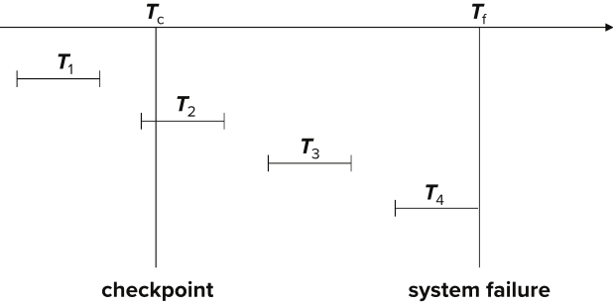
Example of Checkpoints
T₁ can be ignored (updates already output to disk due to checkpoint)
T₂ and T₃ redone.
T₄ undone
T₁ can be ignored (updates already output to disk due to checkpoint)
T₂ and T₃ redone.
T₄ undone

Slide 27
19.4 Recovery Algorithm

Slide 28
Recovery Algorithm
So far: we covered key concepts
Now: we present the components of the basic recovery algorithm
Later: we present extensions to allow more concurrency

Slide 29
Recovery Algorithm
Logging (during normal operation):
<T_{i} start> at transaction start
<T_{i}, X_{j}, V₁, V₂> for each update, and
<T_{i} commit> at transaction end
Transaction rollback (during normal operation)
Let T_{i} be the transaction to be rolled back
Scan log backwards from the end, and for each log record of T_{i} of the form <T_{i}, X_{j}, V₁, V₂>
Perform the undo by writing V₁ to X_{j},
Write a log record <T_{i} , X_{j}, V₁>
such log records are called compensation log records
Once the record <T_{i} start> is found stop the scan and write the log record <T_{i} abort>

Slide 30
Recovery Algorithm (Cont.)
Recovery from failure: Two phases
Redo phase: replay updates of all transactions, whether they committed, aborted, or are incomplete
Undo phase: undo all incomplete transactions
Redo phase:
1. Find last <checkpoint L> record, and set undo-list to L.
2. Scan forward from above <checkpoint L> record
Whenever a record <T_{i}, X_{j}, V₁, V₂> or <T_{i}, X_{j}, V₂> is found, redo it by writing V₂ to X_{j}
Whenever a log record <T_{i} start> is found, add T_{i} to undo-list
Whenever a log record <T_{i} commit> or <T_{i} abort> is found, remove T_{i} from undo-list

Slide 31
Recovery Algorithm (Cont.)
Undo phase:
1. Scan log backwards from end
Whenever a log record <T_{i}, X_{j}, V₁, V₂> is found where T_{i} is in undo-list perform same actions as for transaction rollback:
perform undo by writing V₁ to X_{j}.
write a log record <T_{i} , X_{j}, V₁>
Whenever a log record <T_{i} start> is found where T_{i} is in undo-list,
Write a log record <T_{i} abort>
Remove T_{i} from undo-list
Stop when undo-list is empty
1. i.e., <T_{i} start> has been found for every transaction in undo-list
After undo phase completes, normal transaction processing can commence

Slide 32
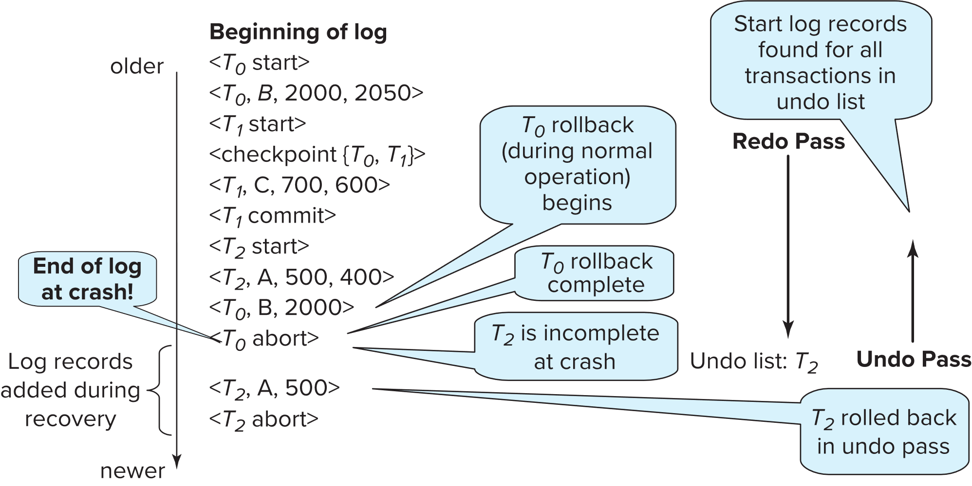
Example of Recovery

Slide 33
19.5 Log Record Buffering
Log record buffering: log records are buffered in main memory, instead of being output directly to stable storage.
Log records are output to stable storage when a block of log records in the buffer is full, or a log force operation is executed.
Log force is performed to commit a transaction by forcing all its log records (including the commit record) to stable storage.
Several log records can thus be output using a single output operation, reducing the I/O cost.

Slide 34
Log Record Buffering (Cont.)
The rules below must be followed if log records are buffered:
Log records are output to stable storage in the order in which they are created.
Transaction T_{i} enters the commit state only when the log record <T_{i} commit> has been output to stable storage.
Before a block of data in main memory is output to the database, all log records pertaining to data in that block must have been output to stable storage.
This rule is called the write-ahead logging or WAL rule
Strictly speaking, WAL only requires undo information to be output

Slide 35
Database Buffering
Database maintains an in-memory buffer of data blocks
When a new block is needed, if buffer is full an existing block needs to be removed from buffer
If the block chosen for removal has been updated, it must be output to disk
The recovery algorithm supports the no-force policy: i.e., updated blocks need not be written to disk when transaction commits
force policy: requires updated blocks to be written at commit
More expensive commit
The recovery algorithm supports the steal policy: i.e., blocks containing updates of uncommitted transactions can be written to disk, even before the transaction commits

Slide 36
Database Buffering (Cont.)
If a block with uncommitted updates is output to disk, log records with undo information for the updates are output to the log on stable storage first
(Write ahead logging)
No updates should be in progress on a block when it is output to disk. Can be ensured as follows.
Before writing a data item, transaction acquires exclusive lock on block containing the data item
Lock can be released once the write is completed.
Such locks held for short duration are called latches.
To output a block to disk
1. First acquire an exclusive latch on the block
Ensures no update can be in progress on the block
2. Then perform a log flush
3. Then output the block to disk
4. Finally release the latch on the block
Notes:
36

Slide 37
Buffer Management (Cont.)
Database buffer can be implemented either
In an area of real main-memory reserved for the database, or
In virtual memory
Implementing buffer in reserved main-memory has drawbacks:
Memory is partitioned before-hand between database buffer and applications, limiting flexibility.
Needs may change, and although operating system knows best how memory should be divided up at any time, it cannot change the partitioning of memory.

Slide 38
Buffer Management (Cont.)
Database buffers are generally implemented in virtual memory in spite of some drawbacks:
When operating system needs to evict a page that has been modified, the page is written to swap space on disk.
When database decides to write buffer page to disk, buffer page may be in swap space, and may have to be read from swap space on disk and output to the database on disk, resulting in extra I/O!
Known as dual paging problem.
Ideally when OS needs to evict a page from the buffer, it should pass control to database, which in turn should
Output the page to database instead of to swap space (making sure to output log records first), if it is modified
Release the page from the buffer, for the OS to use
Dual paging can thus be avoided, but common operating systems do not support such functionality.

Slide 39
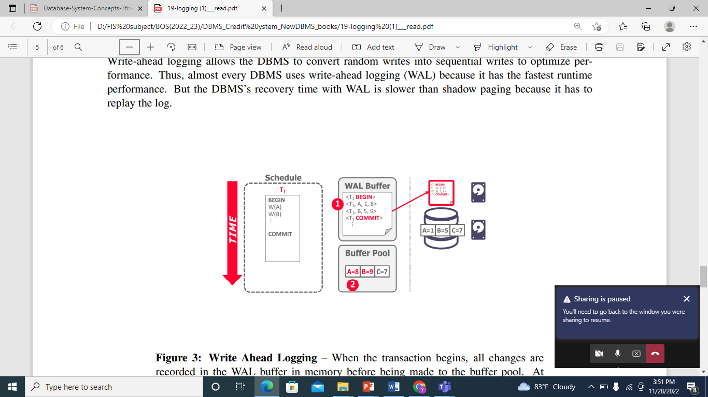

Slide 40
Fuzzy Checkpointing
To avoid long interruption of normal processing during checkpointing, allow updates to happen during checkpointing
Fuzzy checkpointing is done as follows:
1. Temporarily stop all updates by transactions
2. Write a <checkpoint L> log record and force log to stable storage
3. Note list M of modified buffer blocks
4. Now permit transactions to proceed with their actions
5. Output to disk all modified buffer blocks in list M
blocks should not be updated while being output
Follow WAL: all log records pertaining to a block must be output before the block is output
6. Store a pointer to the checkpoint record in a fixed position
last_checkpoint on disk
Notes:
40

Slide 41
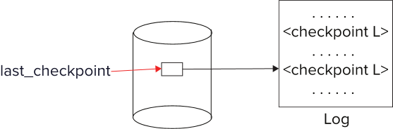
Fuzzy Checkpointing (Cont.)
When recovering using a fuzzy checkpoint, start scan from the checkpoint record pointed to by last_checkpoint
Log records before last_checkpoint have their updates reflected in database on disk, and need not be redone.
Incomplete checkpoints, where system had crashed while performing checkpoint, are handled safely
Notes:
41

Slide 42
19.6 Failure with Loss of Nonvolatile Storage
So far we assumed no loss of non-volatile storage
Technique similar to checkpointing used to deal with loss of non-volatile storage
Periodically dump the entire content of the database to stable storage
No transaction may be active during the dump procedure; a procedure similar to checkpointing must take place
Output all log records currently residing in main memory onto stable storage.
Output all buffer blocks onto the disk.
Copy the contents of the database to stable storage.
Output a record <dump> to log on stable storage.

Slide 43
Backup Database
Back up the database using the following command:
mysqldump -u [username] –p[password] [database_name] > [dump_file.sql]
[username] - A valid MySQL username.
[password] - A valid MySQL password for the user.
[database_name] - A valid Database name you want to take backup.
[dump_file.
C:\Windows\system32>cd\
C:\>cd program files
C:\Program Files>cd mysql
C:\Program Files\MySQL>cd mysql server 8.0
C:\Program Files\MySQL\MySQL Server 8.0>cd bin

Slide 44
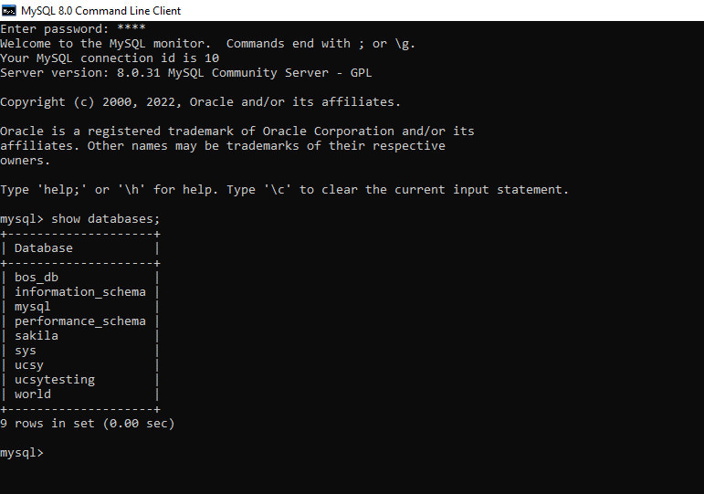
Show database

Slide 45
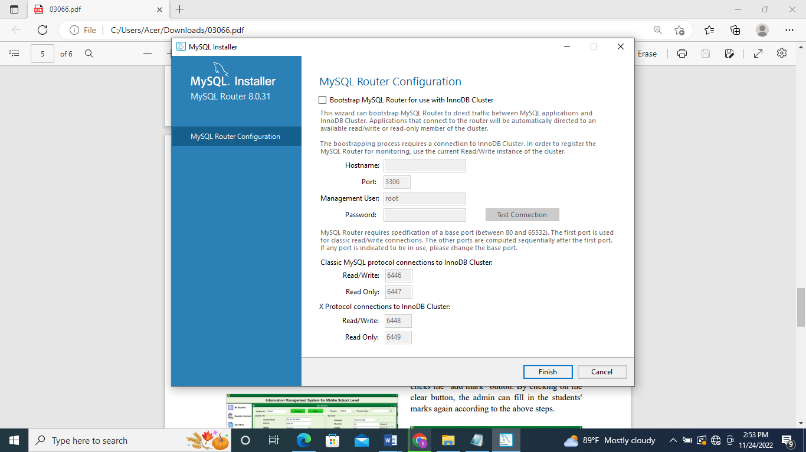
Show Prompt number

Slide 46
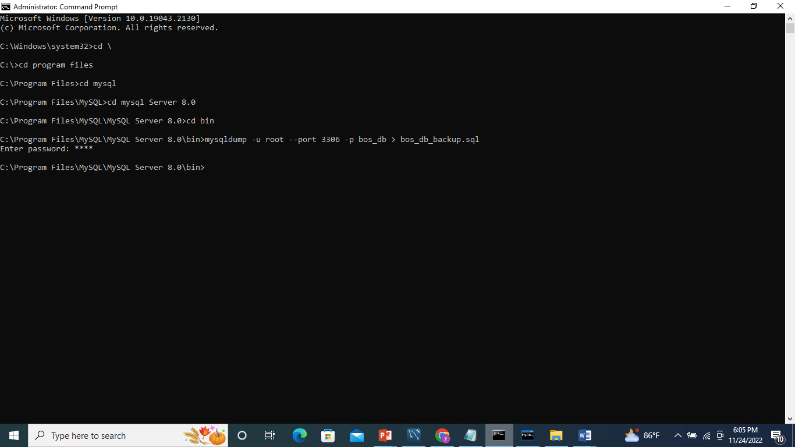
Backup Database : mysqldump –u –port bos_db > bos_db_backup.sql;
Existing database name
backup database name

Slide 47

Mysql server 8.0\bin\bos_db_backup
Backup bos_db_backupb

Slide 48
Recovering from Failure of Non-Volatile Storage
To recover from disk failure
restore database from most recent dump.
Consult the log and redo all transactions that committed after the dump
Can be extended to allow transactions to be active during dump; known as fuzzy dump or online dump
Similar to fuzzy checkpointing

Slide 49
19.7 Remote Backup Systems

Slide 50
Remote Backup Systems
Remote backup systems provide high availability by allowing transaction processing to continue even if the primary site is destroyed.

Slide 51
Show Log file
mysql> show variables like '%general%';
Mysql> Set GLOBAL general_log=‘ON’;
+------------------+---------------------------------------+
| Variable_name | Value |
+------------------+---------------------------------------+
| general_log | OFF |
| general_log_file | /path/to/log |

Slide 52
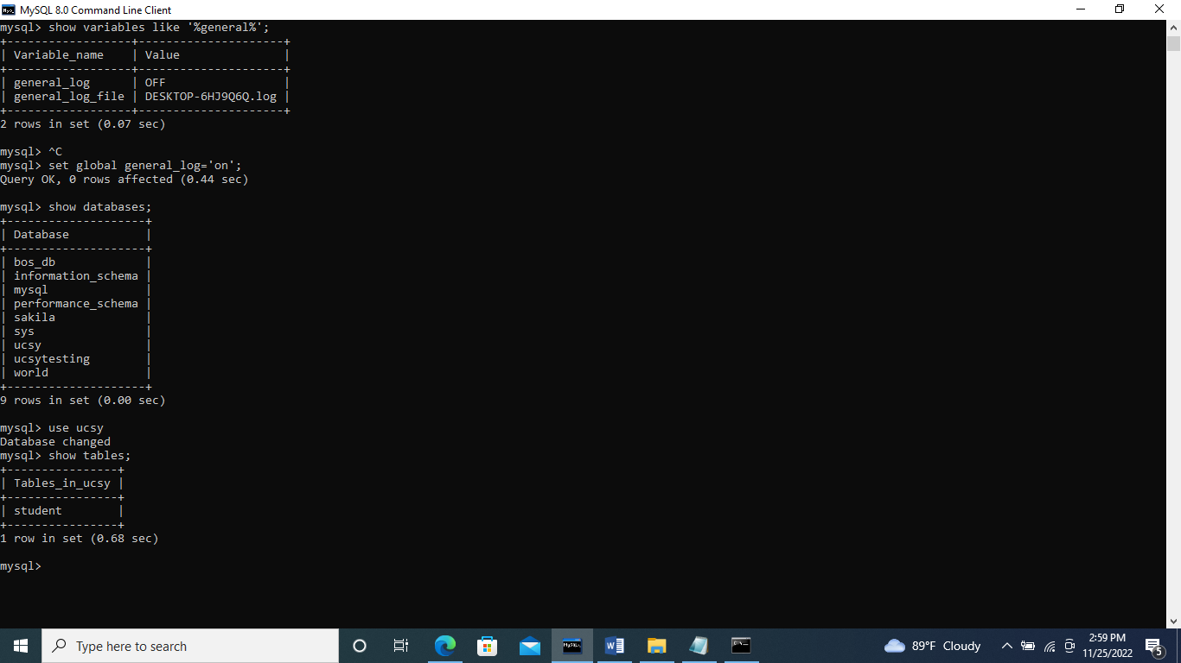
Set Global general_log=‘ON’;

Slide 53
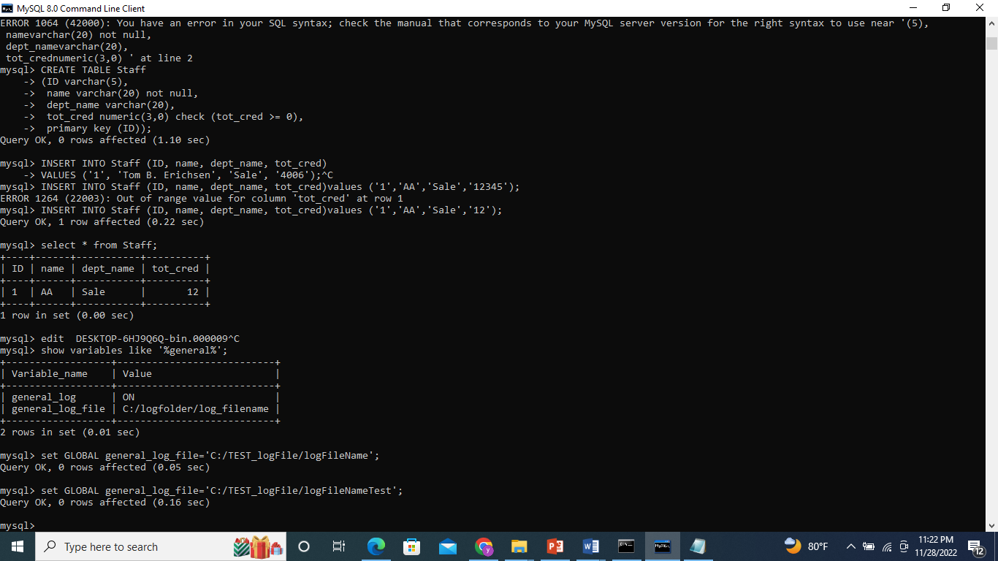
Create Log File: mysql>Set GLOBAL general_log_file=‘C:/Test_logFile/logFileName;

Slide 54
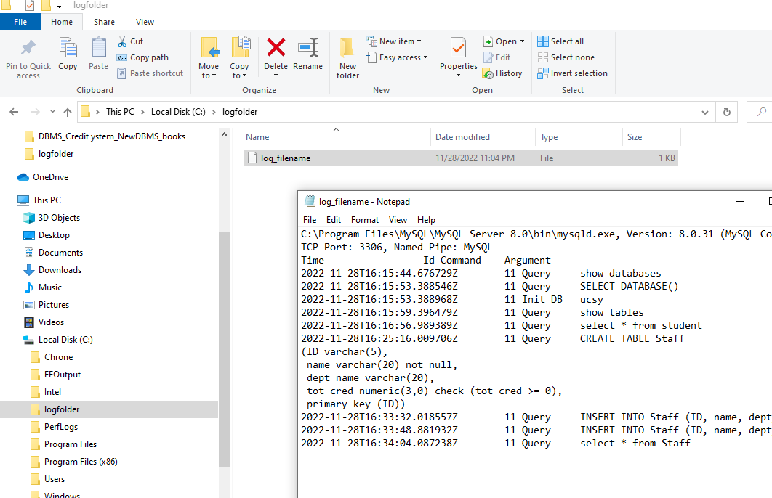
show Log file
set GLOBAL general_log_file=’C:/logfolder/log_filename’;

Slide 55
19.8 Recovery with Early Lock Release and Logical Undo Operations

Slide 56
Text Book: page 935
19.8.1 Logical Operations
The insertion and deletion operations are examples of a class of operations that require logical undo operations since they release locks early; we call such operations logical operations. Such early lock release is important not only for indices, but also for operations on other system data structures that are accessed and updated very frequently; examples include data structures that track the blocks containing records of a relation, the free space in a block, and the free blocks in a database. If locks were not released early after performing operations on such data structures, transactions would tend to run serially, affecting system performance.
The theory of conflict serializability has been extended to operations, based on what operations conflict with what other operations. For example, two insert operations on a B+-tree do not conflict if they insert different key values, even if they both update overlapping areas of the same index page. However, insert and delete operations conflict with other insert and delete operations, as well as with read operations, if they use the same key value. See the bibliographical notes for references to more information on this topic.

Slide 57
Text Book: page 936
Operations acquire lower-level locks while they execute but release them when they complete; the corresponding transaction must however retain a higher-level lock in a two-phase manner to prevent concurrent transactions from executing conflicting actions. For example, while an insert operation is being performed on a B+-tree page, a short-term lock is obtained on the page, allowing entries in the page to be shifted during the insert; the short-term lock is released as soon as the page has been updated. Such early lock release allows a second insert to execute on the same page. However, each transaction must obtain a lock on the key values being inserted or deleted and retain it in a two-phase manner, to prevent a concurrent transaction from executing a conflicting read, insert, or delete operation on the same key value.
Once the lower-level lock is released, the operation cannot be undone by using the old values of updated data items and must instead be undone by executing a compensating operation; such an operation is called a logical undo operation. It is important that the lower-level locks acquired during an operation are sufficient to perform a subsequent logical undo of the operation, for reasons explained later in Section 19.8.4

Slide 58
Text Book: page 936
19.8.2 Logical Undo Log Records
To allow logical undo of operations, before an operation is performed to modify an index, the transaction creates a log record , where Oj is a unique identifier for the operation instance.5 While the system is executing the operation, it creates update log records in the normal fashion for all updates performed by the operation. Thus, the usual old-value and new-value information is written out as usual for each update performed by the operation; the old-value information is required in case the transaction needs to be rolled back before the operation completes. When the operation finishes, it writes an operation-end log record of the form , where the U denotes undo information.
For example, if the operation inserted an entry in a B+-tree, the undo information U would indicate that a deletion operation is to be performed and would identify the B+-tree and what entry to delete from the tree. Such logging of information about operations is called logical logging. In contrast, logging of old-value and new-value information is called physical logging, and the corresponding log records are called physical log records.<Ti ,Oj ,operation_begin> …<Ti ,Oj ,operation_end,U>

Slide 59
Recovery with Early Lock Release
Support for high-concurrency locking techniques, such as those used for B⁺-tree concurrency control, which release locks early
Supports “logical undo”
Recovery based on “repeating history”, whereby recovery executes exactly the same actions as normal processing

Slide 60
Logical Undo Logging
Operations like B⁺-tree insertions and deletions release locks early.
They cannot be undone by restoring old values (physical undo), since once a lock is released, other transactions may have updated the B⁺-tree.
Instead, insertions (resp. deletions) are undone by executing a deletion (resp. insertion) operation (known as logical undo).
For such operations, undo log records should contain the undo operation to be executed
Such logging is called logical undo logging, in contrast to physical undo logging
Operations are called logical operations
Other examples:
delete of tuple, to undo insert of tuple
allows early lock release on space allocation information
subtract amount deposited, to undo deposit
allows early lock release on bank balance

Slide 61
Physical Redo
Redo information is logged physically (that is, new value for each write) even for operations with logical undo
Logical redo is very complicated since database state on disk may not be “operation consistent” when recovery starts
Physical redo logging does not conflict with early lock release
Notes:
Log file have data

Slide 62
Operation Logging
Operation logging is done as follows:
1. When operation starts, log <T_{i}, O_{j}, operation-begin>. Here O_{j} is a
unique identifier of the operation instance.
2. While operation is executing, normal log records with physical redo
and physical undo information are logged.
3. When operation completes, <T_{i}, O_{j}, operation-end, U> is logged,
where U contains information needed to perform a logical undo
information.
Example: insert of (key, record-id) pair (K5, RID7) into index I9 (Key at location X, record-id at location X+8) with old values Old1 and Old2
<T1, O1, operation-begin>
….
<T1, X, Old1, K5>
<T1, X+8, Old2, RID7>
<T1, O1, operation-end, (delete I9, K5, RID7)>
Physical redo of steps in insert

Slide 63
Operation Logging (Cont.)
If crash/rollback occurs before operation completes:
the operation-end log record is not found, and
the physical undo information is used to undo operation.
If crash/rollback occurs after the operation completes:
the operation-end log record is found, and in this case
logical undo is performed using U; the physical undo information for the operation is ignored.
Redo of operation (after crash) still uses physical redo information.

Slide 64
Transaction Rollback with Logical Undo
Rollback of transaction T_{i} is done as follows:
Scan the log backwards
1. If a log record <T_{i}, X, V₁, V₂> is found, perform the undo and log a al
<T_{i}, X, V₁>.
2. If a <T_{i}, O_{j}, operation-end, U> record is found
Rollback the operation logically using the undo information U.
Updates performed during roll back are logged just like during normal operation execution.
At the end of the operation rollback, instead of logging an operation-end record, generate a record
<T_{i}, O_{j}, operation-abort>.
Skip all preceding log records for T_{i} until the record <T_{i}, O_{j} operation-begin> is found

Slide 65
Transaction Rollback with Logical Undo (Cont.)
Transaction rollback, scanning the log backwards (cont.):
3. If a redo-only record is found ignore it
4. If a <T_{i}, O_{j}, operation-abort> record is found:
skip all preceding log records for T_{i} until the record <T_{i}, O_{j}, operation-begin> is found.
5. Stop the scan when the record <T_{i}, start> is found
6. Add a <T_{i}, abort> record to the log
Some points to note:
Cases 3 and 4 above can occur only if the database crashes while a transaction is being rolled back.
Skipping of log records as in case 4 is important to prevent multiple rollback of the same operation.

Slide 66
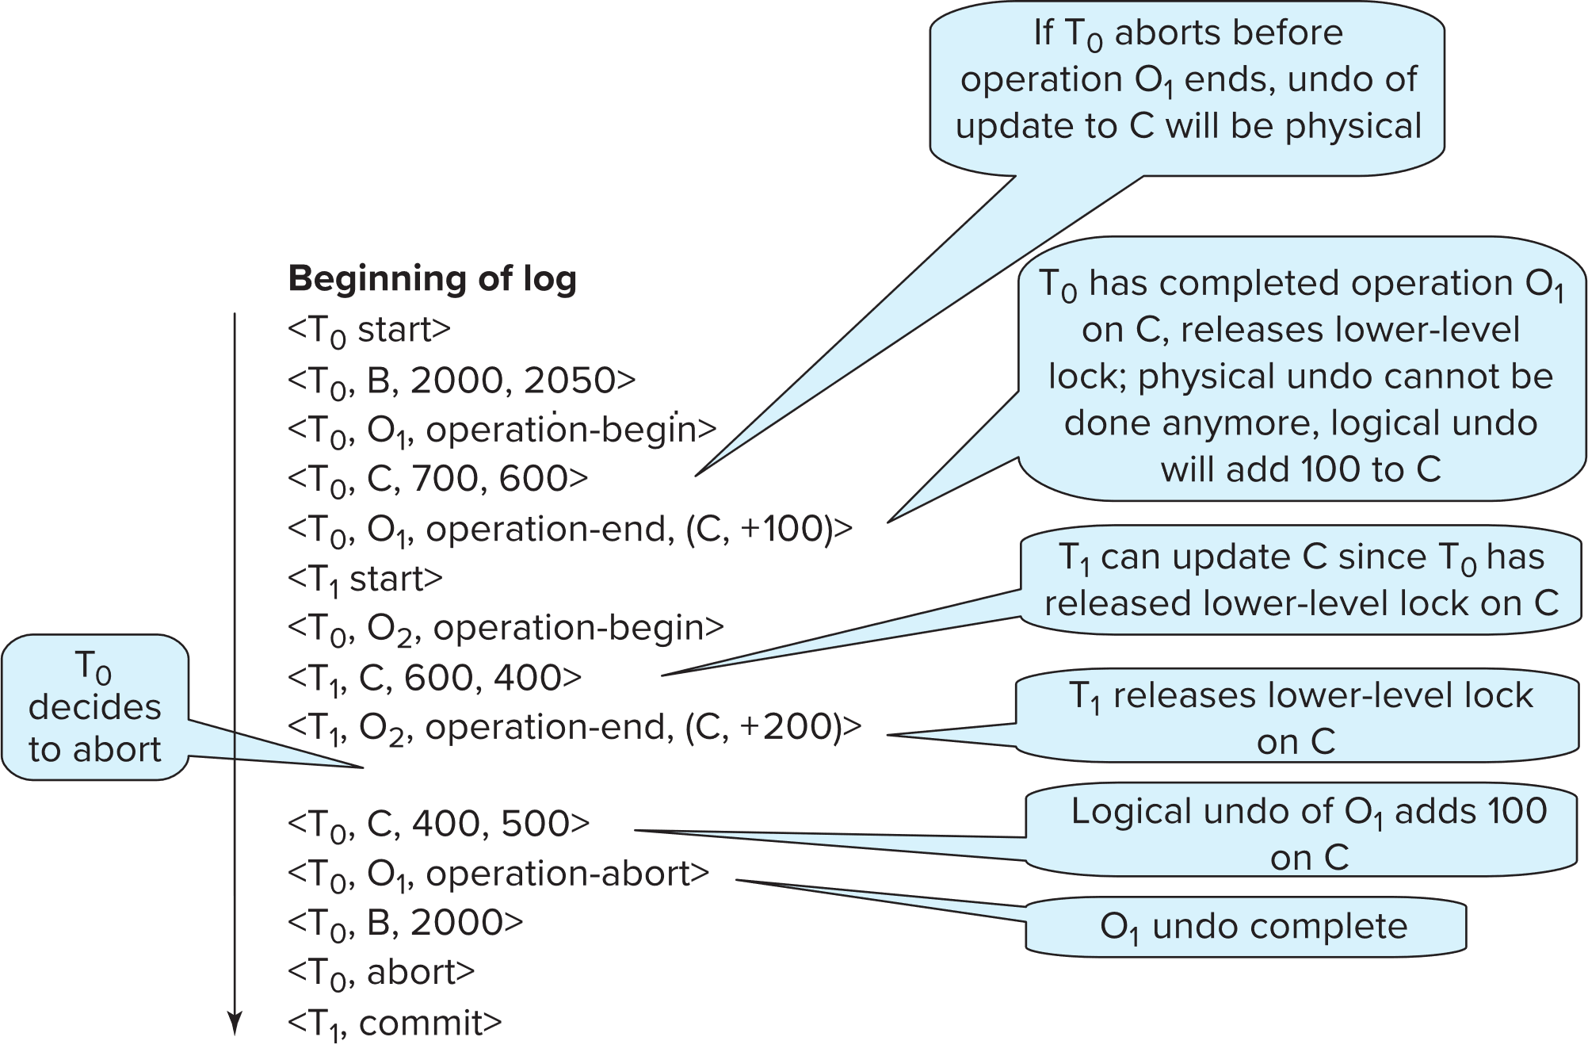
Transaction Rollback with Logical Undo
Transaction rollback during normal operation

Slide 67
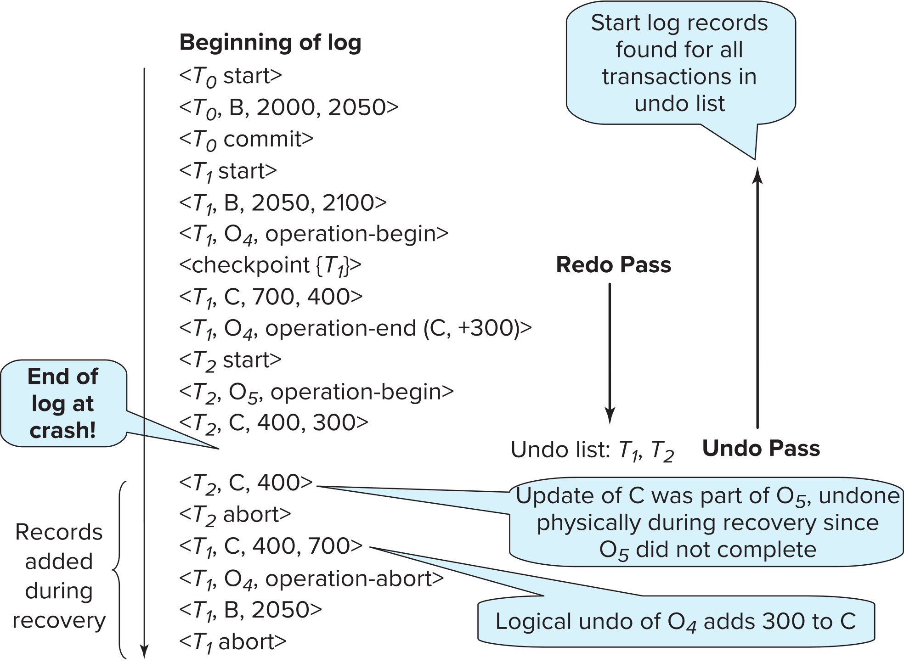
Failure Recovery with Logical Undo

Slide 68
Recovery Algorithm with Logical Undo
Basically same as earlier algorithm, except for changes described earlier for transaction rollback
1. (Redo phase): Scan log forward from last < checkpoint L> record till
end of log
1. Repeat history by physically redoing all updates of all transactions,
2. Create an undo-list during the scan as follows
undo-list is set to L initially
Whenever <T_{i} start> is found T_{i} is added to undo-list
Whenever <T_{i} commit> or <T_{i} abort> is found, T_{i} is deleted from undo-list
This brings database to state as of crash, with committed as well as uncommitted transactions having been redone.
Now undo-list contains transactions that are incomplete, that is, have neither committed nor been fully rolled back.

Slide 69
Recovery with Logical Undo (Cont.)
Recovery from system crash (cont.)
2. (Undo phase): Scan log backwards, performing undo on log records of
transactions found in undo-list.
Log records of transactions being rolled back are processed as described earlier, as they are found
Single shared scan for all transactions being undone
When <T_{i} start> is found for a transaction T_{i} in undo-list, write a <T_{i} abort> log record.
Stop scan when <T_{i} start> records have been found for all T_{i} in undo-list
This undoes the effects of incomplete transactions (those with neither commit nor abort log records). Recovery is now complete.

Slide 70
19.9 ARIES Recovery Algorithm

Slide 71
ARIES
ARIES is a state of the art recovery method
Incorporates numerous optimizations to reduce overheads during normal processing and to speed up recovery
The recovery algorithm we studied earlier is modeled after ARIES, but greatly simplified by removing optimizations
Unlike the recovery algorithm described earlier, ARIES
1. Uses log sequence number (LSN) to identify log records
Stores LSNs in pages to identify what updates have already been applied to a database page
2. Physiological redo
3. Dirty page table to avoid unnecessary redos during recovery
4. Fuzzy checkpointing that only records information about dirty pages,
and does not require dirty pages to be written out at checkpoint time
More coming up on each of the above …

Slide 72
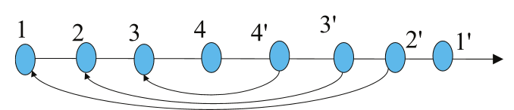
ARIES Data Structures: Log Record
Each log record contains LSN of previous log record of the same transaction
LSN in log record may be implicit
Special redo-only log record called compensation log record (CLR) used to log actions taken during recovery that never need to be undone
Serves the role of operation-abort log records used in earlier recovery algorithm
Has a field UndoNextLSN to note next (earlier) record to be undone
Records in between would have already been undone
Required to avoid repeated undo of already undone actions
LSN TransID PrevLSN RedoInfo UndoInfo
LSN TransID UndoNextLSN RedoInfo

Slide 73
ARIES Data Structures: DirtyPage Table
DirtyPageTable
List of pages in the buffer that have been updated
Contains, for each such page
PageLSN of the page
RecLSN is an LSN such that log records before this LSN have already been applied to the page version on disk
Set to current end of log when a page is inserted into dirty page table (just before being updated)
Recorded in checkpoints, helps to minimize redo work

Slide 74
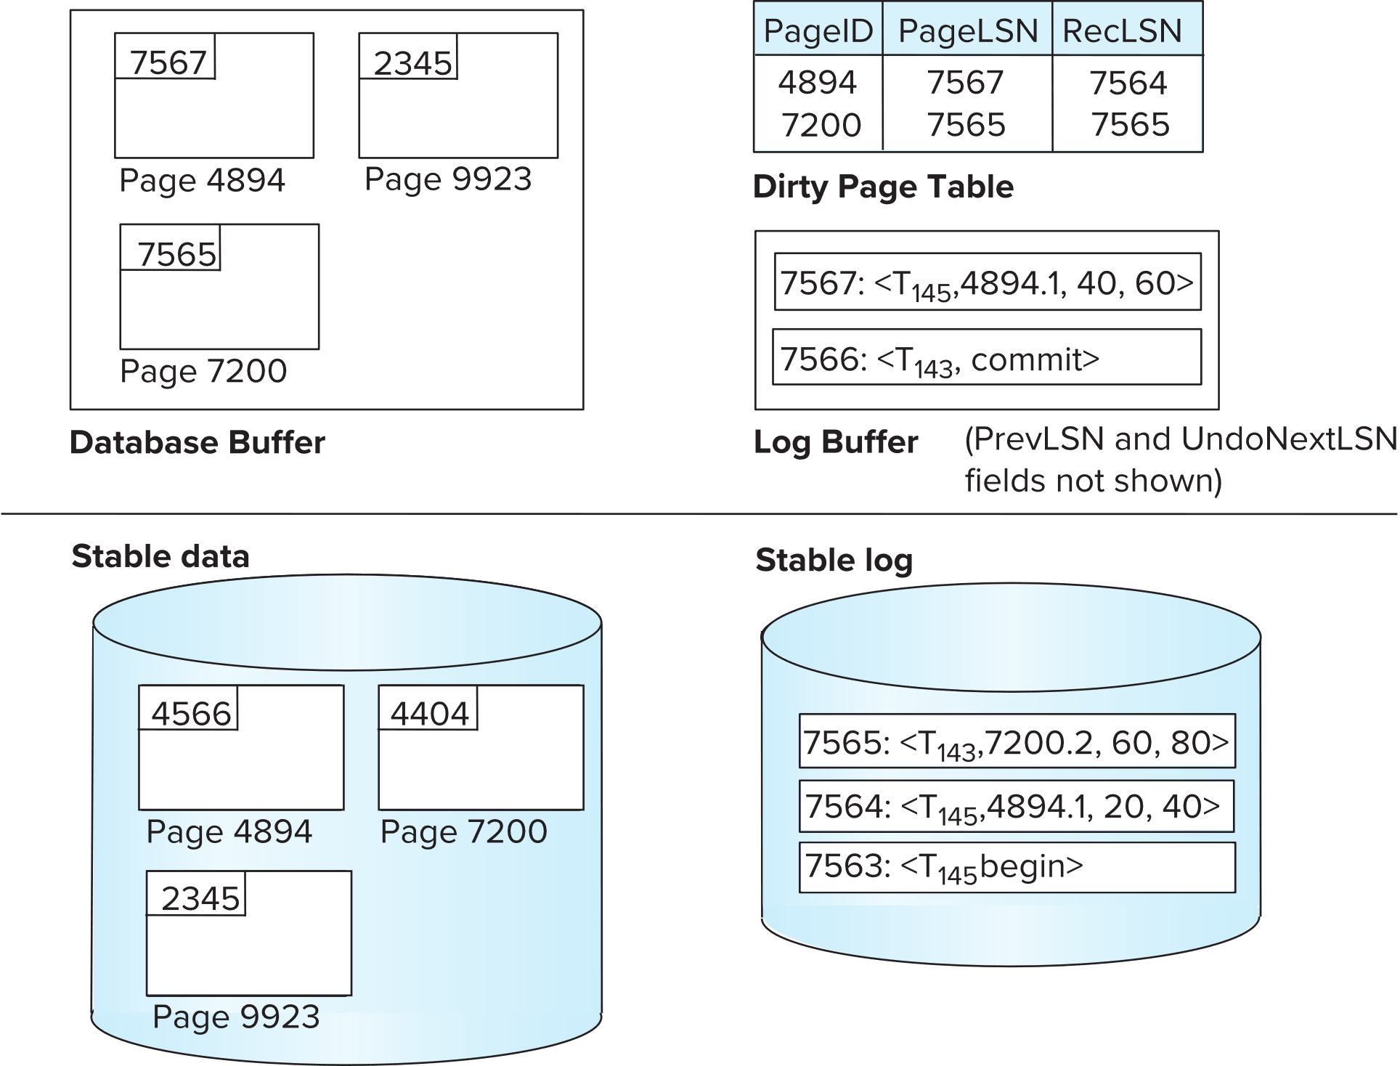
ARIES Data Structures

Slide 75
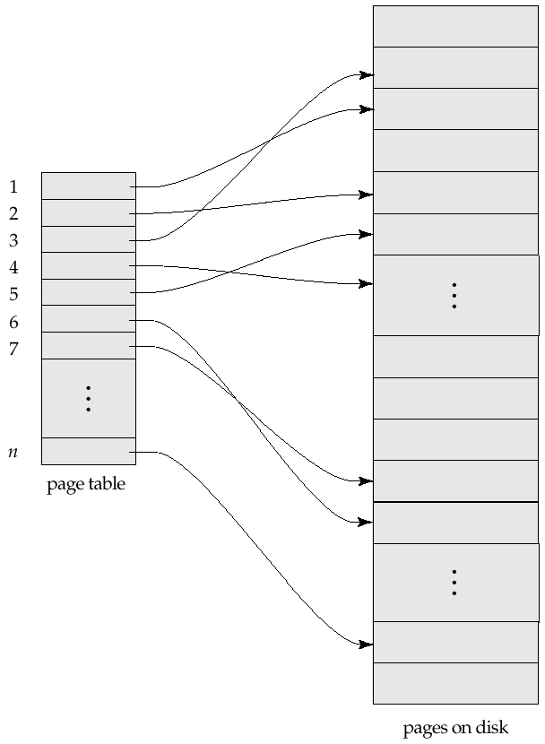
Sample Page Table

Slide 76
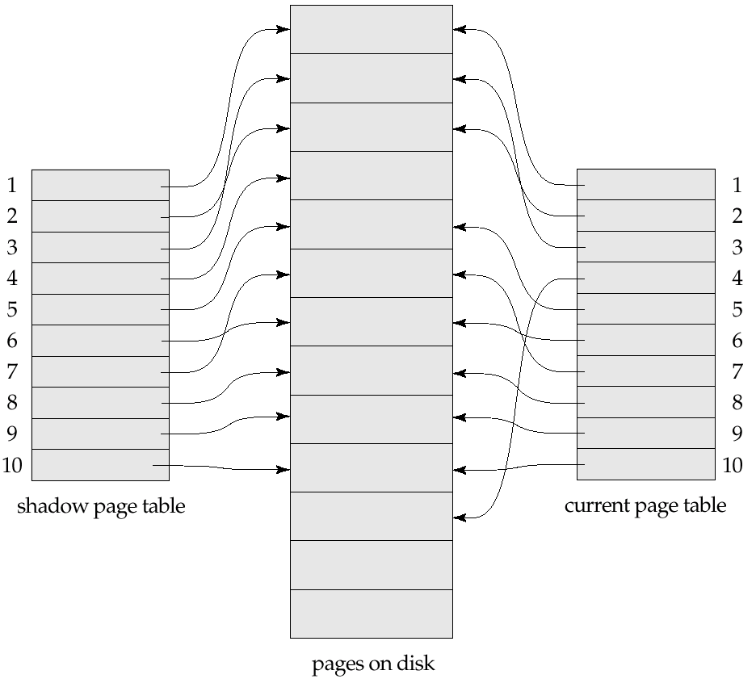
Example of Shadow Paging
Shadow and current page tables after write to page 4

Slide 77
End of Chapter 19

